Slide 1

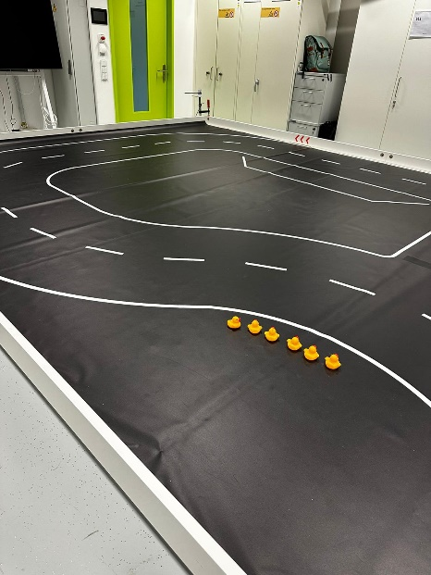
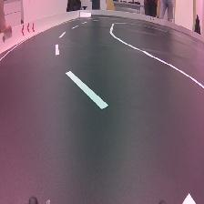
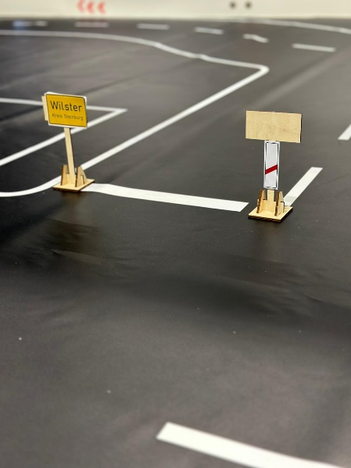
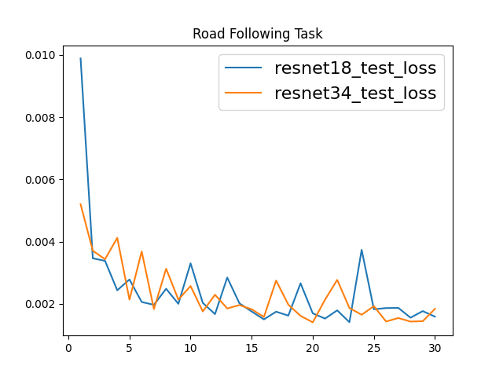
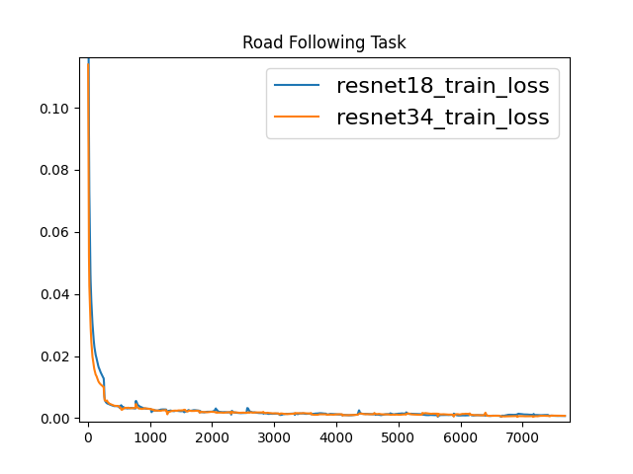

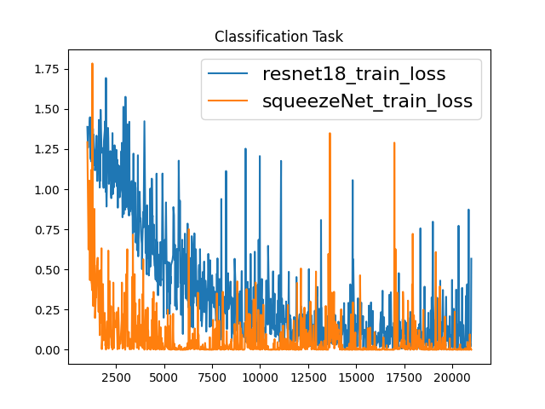
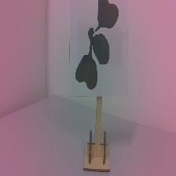
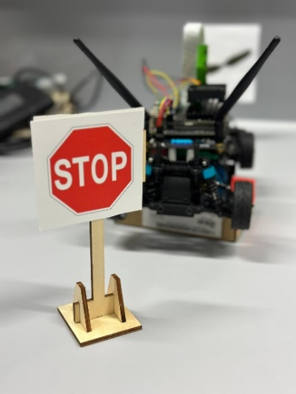
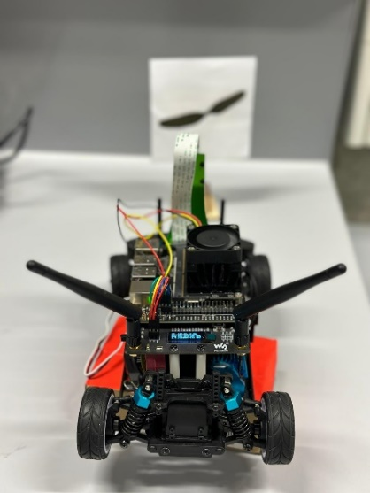
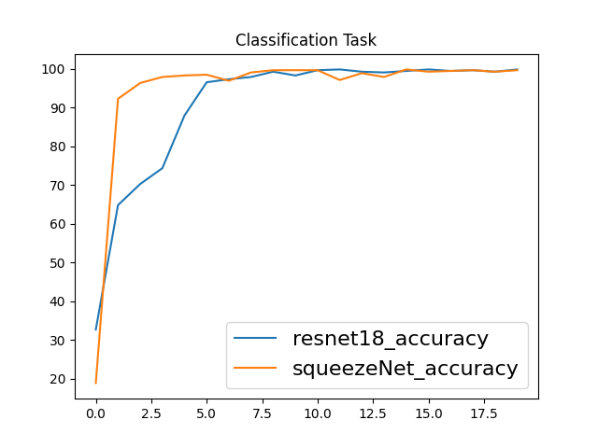
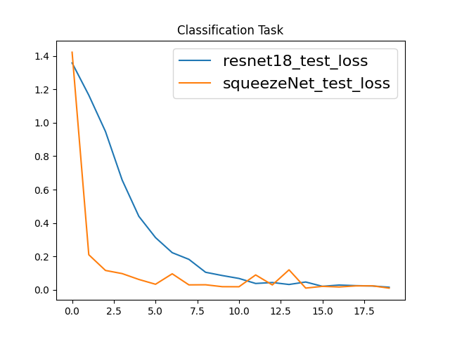

Group 3
Tao Zhao
Ali Beiti Aydenlou
Ferhad Gulizada
Negin Amiri
Danial Rafiee
Farm Guard
Cognitive Behavior
Summer School
Embedded Systems Engineering
Test Environment
Road with 1:10 scale of real environment
3.5m * 7.5m
Including turning and side signs
Different light conditions
Various speeds posible
JetRacer POV
Training Environment
Road Following
Road Signs
Data Gathering (JupyterLab environment)
2500 images, 80% for training, 20% for Testing
Data Labeling: Return x and y
Network: ResNet18 and ResNet34
Data Augmentation
Classification
4 main categories of signs
Augmentation the data
Classification Testing
Data Augmentation

